Slide 1
PROPOSITION 56 GUIDELINES- PROHEALTH PHYSICIANS
Guidelines as of 11—29-2023

Slide 2
Proposition 56 – Overview
What is Proposition 56?
Answer: Proposition 56 was approved by State of California in 2016. The program pays additional reimbursement to providers treating Medi-cal and Medi-cal HMO Members. The program only pays for services rendered in the “office”. They program only pays for some CPT codes not all.
When do we get these payments?
Answer: These payments are paid out throughout the year. They usually come from the Health Plans (Example: LA Care, Blue Cross MCL, Molina, HealthNet, etc)

Slide 3
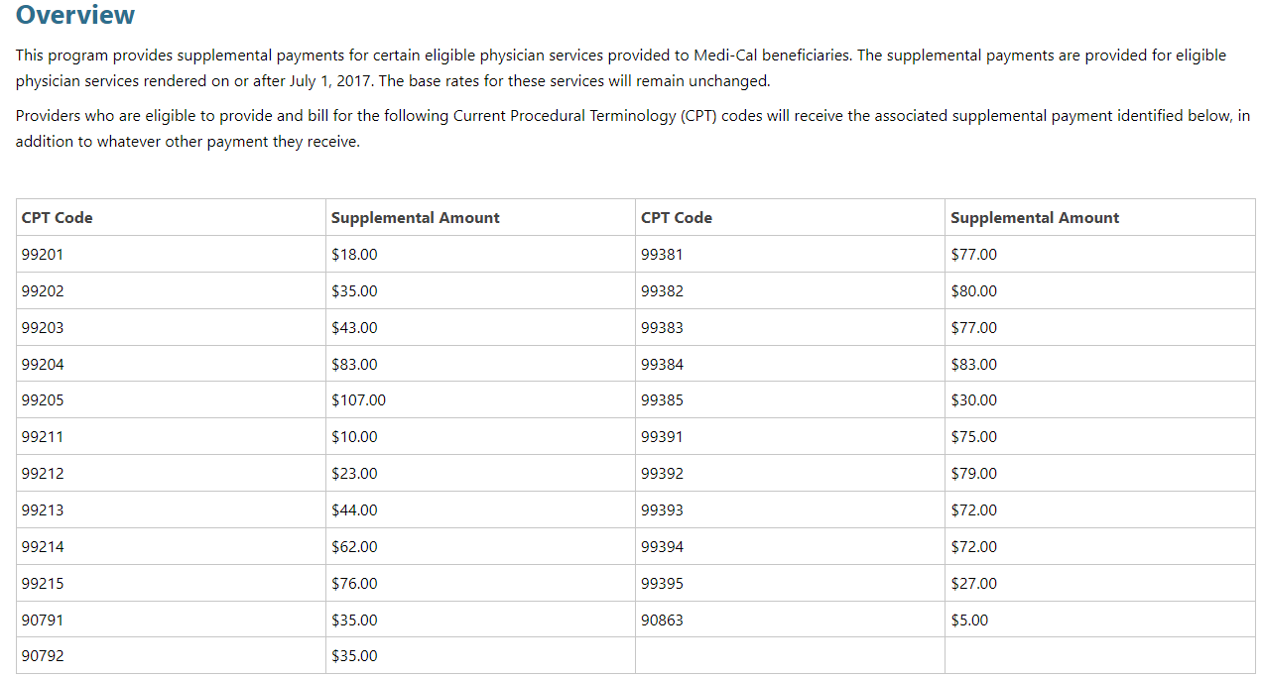
Proposition 56 – Payable CPT codes

Slide 4
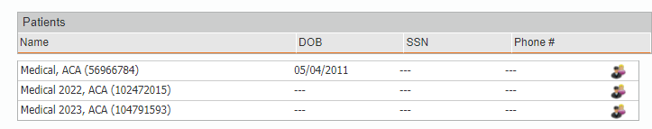
POSTING PROCESS
When the payments come, the EOB should list the Providers and the amount each Provider is receiving.
If we get a payment and we are not able to obtain the “back-up” EOB from the payer, you will need to let the Argus Payments team know (Martha or Janett). These payments can not be posted in “suspense”
How are these payments posted?:
They should be posted into the Medical ACA account. See below. We should have one account per year. Example, Prop. 56 payments coming in 2024, should be posted into a new account called Medical 2024, ACA, etc.

Slide 5
POSTING PROCESS
The allocation of these proposition 56 payments is critical.
When keying the charge to post the payments, the staff must:
Make sure they are under the correct group of the provider.
If the provider is in multiple groups, they need to reach out to Janett, Martha or Eva and ask for Help. We must key the charge and post the payment using the correct group, the correct provider and the correct location.
For Providers with Nurse Practitioners, working on what we called “eat what you catch”, we have to allocate some of the Prop. 56 payments to these mid levels. Eat what you catch means that they don’t get paid a salary. They get paid based on the collections for seeing the patients. (See next slide for a list of these providers).
Term Clients: Providers who are receiving proposition 56 payments after the 6 months deadline, we can not post these payments to the “Term Client Account”. See slide regarding this guideline on how to post Prop. 56 clients on term Clients.
Example: Dr. Hosseini left on 10-31-2023.
Per guideline, we will continue to post payments under his group in CT for 6 months.
As of 4-30-24, we will be closing his database.
If a Prop. 56 payment comes in July of 2024, we can not post this payment to the “term client account number”. See slide # 8 for instructions on how to allocate this money.

Slide 6
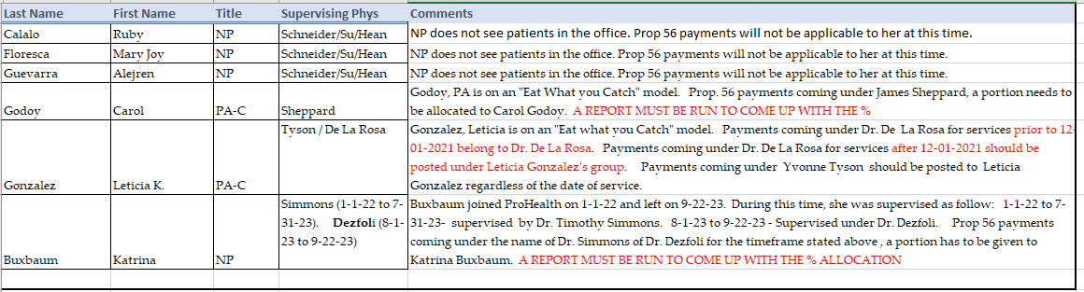
NURSE PRACTITIONERS (NP’s) OR PHYSICIAN ASSISTANT (PA’s)
NP’S OR PA’S WITH A PRACTICE ON WHAT WE CALLED “EAT WHAT YOU CATCH”.
The payments will come under the name of the supervising physician.
This is because when we do the charge entry and the billing, we don’t bill using the PA or the NP as the billing Provider. Therefore, when the payments come, they will come under the name of the doctor (the doctor that is supervising the NP or the PA).
Payments have to be allocated correctly.

Slide 7
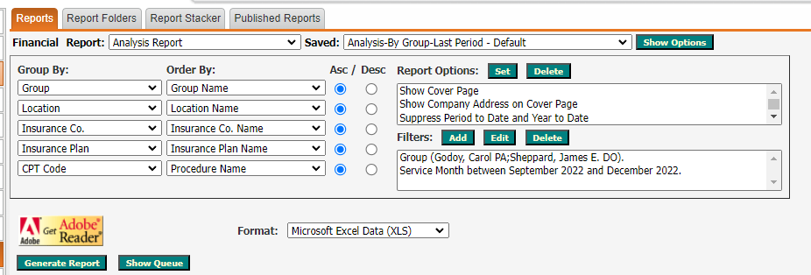
RUNNING THE REPORT TO COME UP WITH ALLOCATION
First look at the payments and look at the date of services getting paid. Example: If the payment is for services between 9-1-2022 to 12-31-2023, and you are trying to obtain the distribution for Dr. Sheppard and Godoy, you will run the report as follow:
2. Once the report runs, you will delete all locations, except for the ones related to office.
You will delete all insurance plans, except for the ones related to Medi-cal or Medi-cal HMO’s.
You will delete all CPT codes Except the ones related to Prop 56.
Then, calculate the data. What is the % of these patients treated by Sheppard and Godoy.
Then, allocate the Prop. 56 payments accordingly.

Slide 8
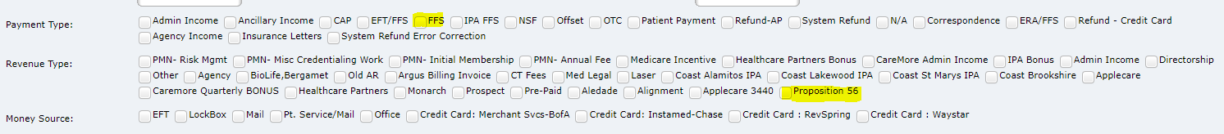
Prop. 56 payments for Term Clients
When a provider leaves ProHealth, we usually continue to post payments in the CT system for 6 months
What if we get a payment for Prop. 56 and it has been longer than 6 months. The group in CT is no longer active. What do we do?
Answer: We can not post Prop. 56 payments to the “term doctor” account number in CT.
If # 2 above happens, we will do the following.
We will post the payment in Argus Core.
We select 1. Payment Type: FFS
We will select Revenue type: Proposition 56.
Christina in Accounting will be pulling this revenue. She will be given the payments to the doctors and keeping a billing and a management fee.

Slide 9
Other:

